Slide 1


SocialOffset
October 2023
SocialOffset.org
Admin@SocialOffset.org Or Elena @SocialOffset.org
SocialOffset has IRS 501(c)3 nonprofit classification. EIN is 92-0238240.

Slide 2
Local Donations Instead of Destination Boycotts
Like a carbon offset model, SocialOffset enables a charitable donation that “offsets” tax dollars spent in a destination with policies that run counter to personal values.
100% of individual donations go to vetted local charities we work with event organizers to select.
www.SocialOffset.org

Slide 3
So
what can you do with SocialOffset?
Event Organizers
Destination Reps
Event Attendees
“
As an event organizer hosting a conference in a non-inclusive state, I have concerns that some attendees want us to cancel it. We are one bad tweet away from a major issue.
“
As a destination rep I am worried: groups are considering moving their events or going virtual instead of coming here because of our state’s laws. I need a way to help my clients and help our city.
“
As an attendee I’m upset that an important event is in a state with policies I don’t agree with, and I’m considering not going.
Create
Launch
Attend
Event organizers can create a custom campaign page to collect offset donations for local charities.
Destination reps can create a page to highlight local charities and show your clients you support their values.
Attendees can donate through the SocialOffset custom event page to “offset” the tax money collected by the state.

Slide 4


Event Organizers
“
As an event organizer hosting a conference in a non-inclusive state, I have concerns that some attendees want us to cancel it. We are one bad tweet away from a major issue.
Create
Event organizers can create a custom campaign page to collect offset donations for local charities.

Slide 5

Destination Reps
“
As a destination rep I am worried: groups are considering moving their events or going virtual instead of coming here because of our state’s laws. I need a way to help my clients and help our city.
Launch
Destination reps can create a page to highlight local charities and show your clients you support their values.

Slide 6

Event Attendees
“
As an attendee I’m upset that an important event is in a state with policies I don’t agree with, and I’m considering not going.
Attend
Attendees can donate through the SocialOffset custom event page to “offset” the tax money collected by the state.

Slide 7

Our Guiding Principles
We validate that people may be uncomfortable visiting destinations where laws and policies go against their core values.
We believe boycotting event destinations hurt the very people many of us want to help so local donations make a more powerful impact than boycotting event destinations.
Our intent is to enable donations to local charities to offset visitors’ tax dollars spent that support policies against their personal values while supporting in-person events.
Causes
Racial Justice
Reproductive Freedom
LGBTQ+ Equality
Environmental Sustainability
Housing Security
Hunger Relief
SocialOffset.org

Slide 8





SocialOffset
Founding
Funders
NEWEST
Dallas
Birmingham
Orlando
SocialOffset.org

Slide 9

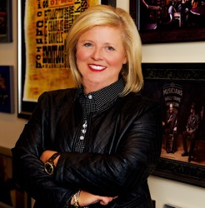

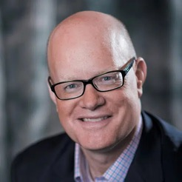
Why Support SocialOffset?
Deana Ivey
CEO, Nashville Convention & Visitors Corp
"Nashville is an open, welcoming city that respects and embraces the differences among us. We believe that our differences make our community stronger. The city, the industry and the NCVC have worked tirelessly on solutions in support of equity, inclusivity, sustainability and moderation. Boycotting cities does not help change laws or the minds of political leaders. Instead, it could inadvertently harm front line industry employees. So instead, make your voice heard by meeting in Music City and join our efforts! SocialOffset is a great way to help make those local connections, and we are proud to sponsor this effort. And, our organization is always happy to help further brainstorm in finding ways to make a positive community impact during your event in Nashville."
Tom Noonan
President & CEO, Visit Austin
"Partnering with SocialOffset gives Visit Austin the platform to share with event planners and attendees many of the social issues that our community is proud to support. Not only are clients able to learn about these local non-profits through SocialOffset, but they also have the ability to support them, as well, through donations, volunteering opportunities and many more. It’s just another great tool that allows us to best serve our clients, visitors and the Austin community.”
SocialOffset.org

Slide 10

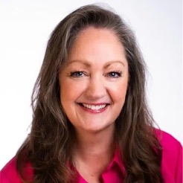

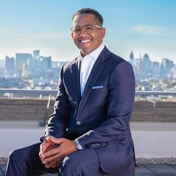
Why Support SocialOffset?
Tammy Blount-Canavan, FCDME
Visit Seattle, President & CEO
“Social Offset is the perfect solution to planners and delegates looking for a way to use their voice (and their wallet) to support causes important to them, regardless of the external environment, regulations or circumstances. Boycotts don’t hurt the policy-makers, they hurt the people who need the business the most – the people delivering the services. This important option is available to anyone visiting a destination, whether you want to make a statement about local policy, or simply support a good cause you believe in and invest in the community you’re visiting."
Al Hutchinson
President and CEO
Here in Baltimore, inclusivity is at the forefront of what we do. We are committed to embracing our city’s rich diversity and striving to create a welcoming environment for a diverse array of travelers. As part of this commitment, we are excited to partner with SocialOffset to provide a platform to meeting planners that helps benefit local organizations making a difference in our community as the hospitality community works to address the social challenges taking place in destinations across the nation. At Visit Baltimore, we truly believe that the destination is only as healthy as your community. The more we can connect with local organizations to address the ongoing challenges within our individual communities, the more we can work to solve the greater issues taking place in cities
SocialOffset.org

Slide 11
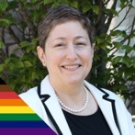
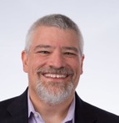
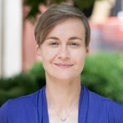



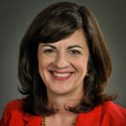
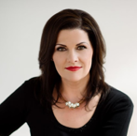


Board of Directors
Elena Gerstmann, Chair
Marc Beebe, Treasurer
Beth Surmont, Secretary
Rhonda Payne
Erin Fuller
James Pogue
Christie Tarantino-Dean
KiKi L'Italien
Advisors
Sheri Jacobs
Brad Weaber
SocialOffset.org

Slide 12
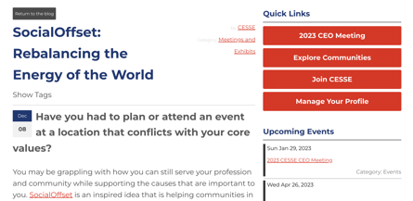

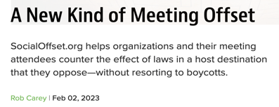

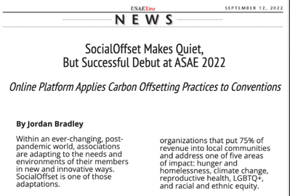
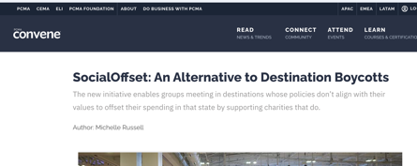
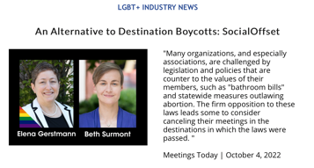


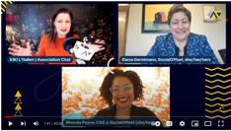
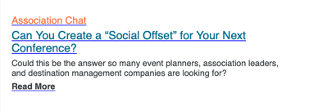

Sample of Earned Media

Slide 13
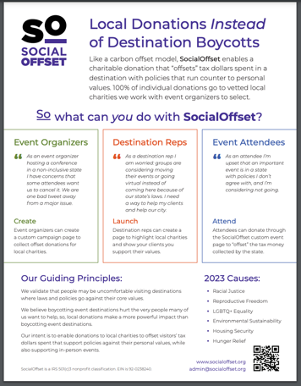
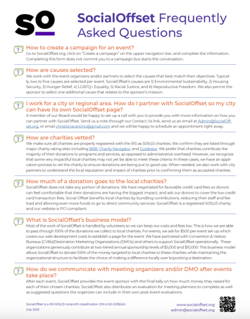
Two “flyers”
SocialOffset.org

Slide 14
Custom Page for Event Organizers
We work with you to create a SocialOffset.org/events/YourEventName custom campaign page to collect offset donations for local charities. You can identify causes and charities that align with your event/organizational values, or we can identify charities for you.
All donations are collected through the SocialOffset.org/events/YourEventName Page site and distributed to the charity.
You have the option to include custom messaging as well as sponsor recognition.
A flat fee is charged to cover the administrative costs of site build,
hosting, and credit card fees.
Nonprofits, including Associations
$750 per event page
For-profit Corporations and Other Businesses
$1500 per event page
SocialOffset.org

Slide 15
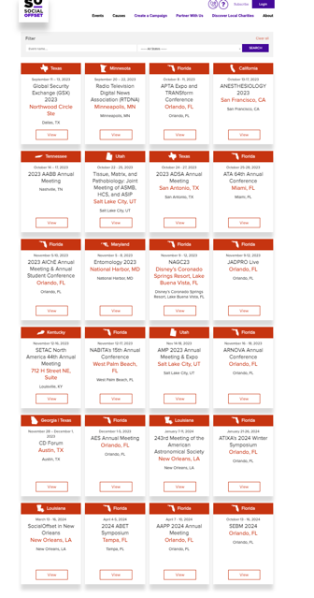
Current Events
SocialOffset.org

Slide 16
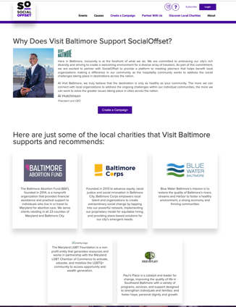
Custom City Page for Destinations
We work with you to create a SocialOffset.org/partners/YourCity custom webpage to highlight your commitment to support local causes. You can showcase charities you are already working with, or we can work with you to identify and vet local charities.
You also have the option to sponsor an event page for any potential event business coming into your city.
Partner investments range
from $5,000 to $10,000.
SocialOffset.org

Slide 17

FAQs
Isn’t boycotting the destination making more of an impact?
Canceling an event hurts the people who need help the most. Many hospitality workers are only paid when an event is in town. For example, in Nashville, 73% of the hospitality housekeeping staff are women. An event boycott would have a huge negative impact on this local community.
In addition, boycotting a destination only serves to create further division. Events are about bringing people together and when a city is left out, then members and the public are left behind.
Also, research conducted by Destinations International shows that event boycotts are not effective in making social change.
We believe in doing something over doing nothing. Our analogy is that boycotting is like taking your ball and going home. Using SocialOffset and attending a meeting in a state you don’t agree with is like staying, playing ball, and making the playground a better place.
SocialOffset.org

Slide 18
FAQs
How does SocialOffset select the charities used? Can I recommend a charity?
All charities are vetted. We make sure all charities are properly registered with the IRS as 501(c)3 charities. We check to see if they are listed through BBB, Charity Navigator, GiveWell, CharityWatch, or Guidestar.
We prefer that charities contribute the majority of their funds to programs and services, as opposed to administrative overheard. However, we recognize that some very impactful local charities may not yet be able to meet these criteria. In these cases, we have an application process to vet the charity to ensure your donation is being put to good use.
Yes, you can recommend a charity. Please send us an email at
admin@socialoffset.org
SocialOffset.org

Slide 19
FAQs
Is this a product you are selling? Are you making money off of this?
No, this is a larger social concept that we are promoting. We believe that event boycotts hurt our local communities and serve to further divide our country. SocialOffset allows us to still gather while ensuring people are able to balance the money spent (tax dollars) in a location with their personal values.
Is this greenwashing?
No. We ensure that the charities and organizations are aligned with SocialOffset’s mission of removing barriers, creating agency, and helping event attendees and business travelers offset spending in destinations whose laws do not align with their core values by making it easy to donate to local charities that do.
SocialOffset.org

